Slide 1



By Sarni YOUNES
CAPTURE THE FLAG SECURITY CHALLENGE
AN INTERACTIVE CYBERSECURITY
EXPERIENCE
ys-dev.me
Cyber-Security is much more than a matter of IT.
With
American Corner

Slide 2


Table Of Content
1. What is a vulnerability?
A security vulnerability is a weakness in a system that can be exploited to compromise its integrity.
2.How to identify a vulnerability?
Exploration of tools and methods for vulnerability detection
3.What is SQL?
Exploration of tools and methods for vulnerability detection
4.How to exploit a vulnerability?
Demonstration of exploiting a vulnerability using payloads
5.Why does it happen?
Analysis of the underlying causes of security vulnerabilities.
6.How to resolve it?
Presentation of security best practices to address vulnerabilities.
7.The dangers of SQL injection vulnerability:
Exploration of potential consequences and risks associated with SQL injection vulnerability.

Slide 3




1. What is a vulnerability?
A vulnerability is a weakness or flaw in a system, software, or process that can be exploited by attackers to compromise the security of the system.
Types of Vulnerabilities:
Software
Human-Related
Human-Related
Issues in code that can be exploited (e.g., buffer overflows, SQL injection).
Mistakes or oversights made by individuals (e.g., weak passwords, social engineering).
ncorrectly configured settings that expose security weaknesses.
Notes:
asque vous avez deja etendu d'une vulnerabliite deja exploiter ou jamais

Slide 4
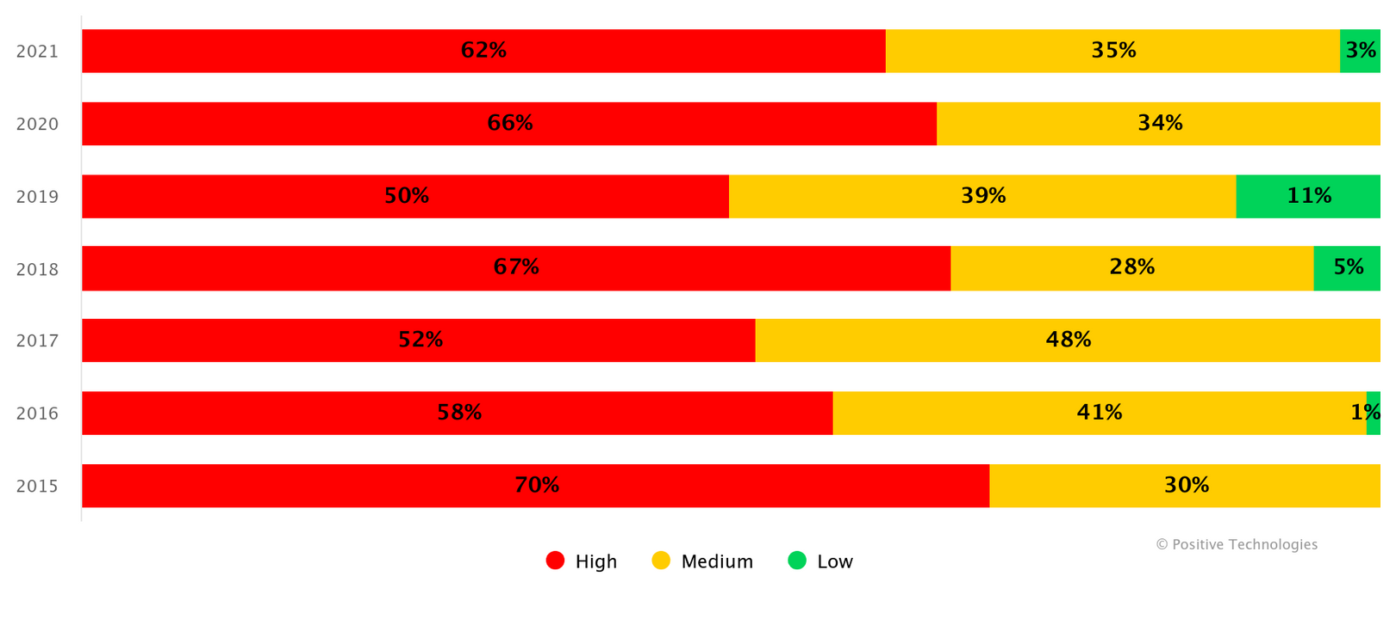
Some Statistics
Web application vulnerabilities© Positive Technologies

Slide 5







2.How to identify a vulnerability?
Reconnaissance and Information Gathering:
Enumerate Services:
Passive Reconnaissance:
Use tools like Nmap or automated scanners to identify open ports and services on target systems.
Gather information about the target organization from publicly available sources, such as WHOIS databases or social media.

Slide 6



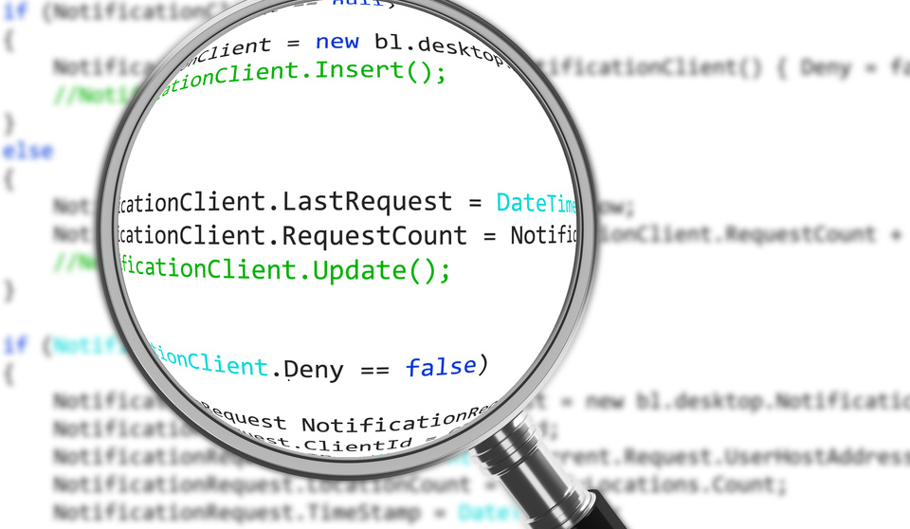
2.How to identify a vulnerability?
Manual Testing
Manual Penetration Testing:
Code Review:
Conduct manual penetration tests to discover vulnerabilities that automated tools may miss
If applicable, review source code for security flaws and vulnerabilities.

Slide 7


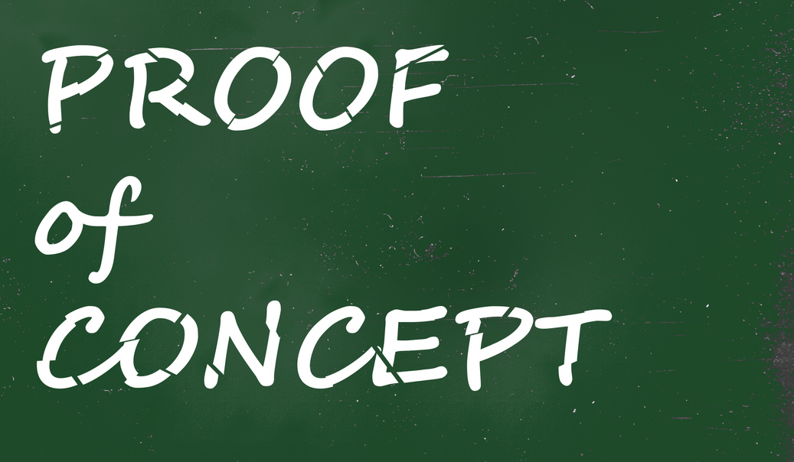

2.How to identify a vulnerability?
Exploitation Techniques:
Proof of Concept (PoC):
Social Engineering:
Develop and execute PoCs to validate the existence of vulnerabilities.
If within the scope, employ social engineering tactics to identify potential weaknesses in human interactions.

Slide 8

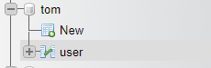
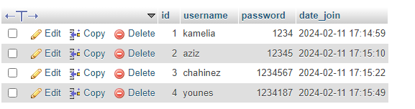
3.WHATS is SQL (Structured Query Language)
SQL (Structured Query Language):
is a specialized programming language designed for managing and manipulating relational databases. It serves as the standard language for interacting with relational database management systems MySQL, PostgreSQL, SQLite, and Microsoft SQL Server.
database “tom”
Column
DATA

Slide 9
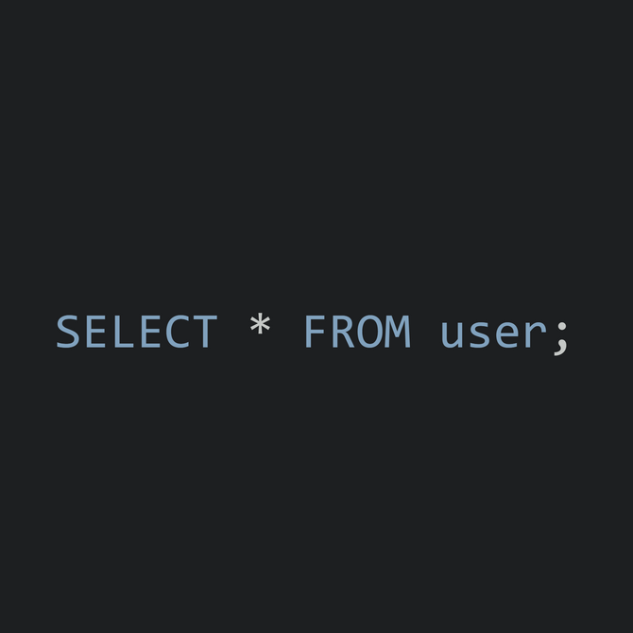
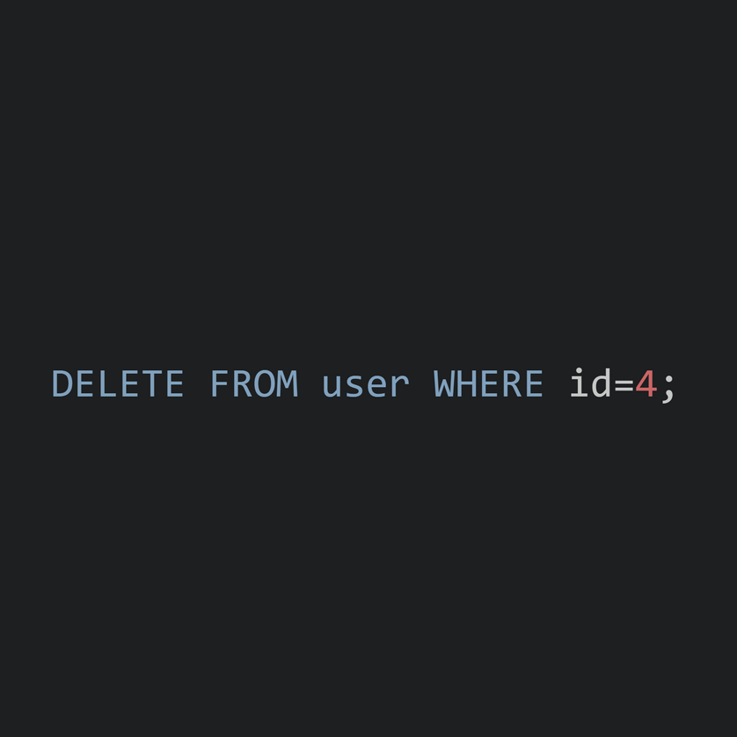
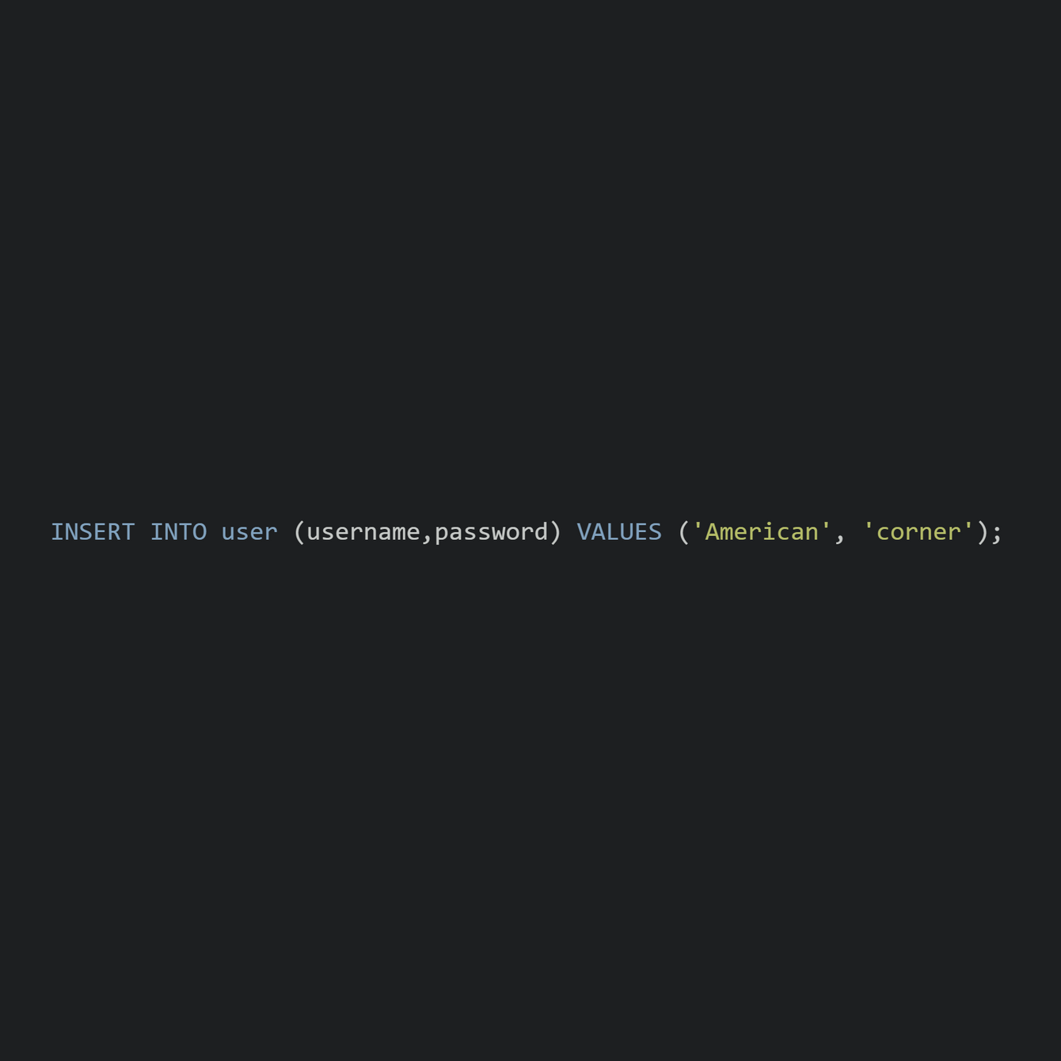
3.WHATS is SQL (Structured Query Language)
Example SQL Queries:
id | username | password | date_join
1 | kamelia | 1234 | 2024-02-11 17:14:59
2 | aziz | 12345 | 2024-02-11 17:15:10
3 | chahinez | 1234567 | 2024-02-11 17:15:22
4 | younes | 1234187 | 2024-02-11 17:15:49
5 | American | corner | 2024-02-15 13:00:00
get all data of table User:
Delete records :
Insert a new record:
--
in sql is like a comment

Slide 10
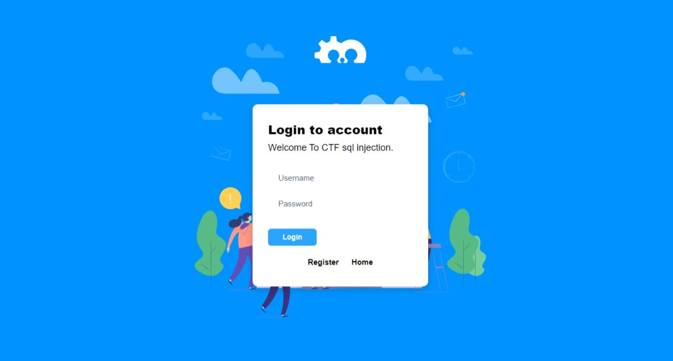
4.How to exploit a vulnerability? (exemple)
Scenario:
Consider a web application with a login page that has a SQL injection vulnerability. The goal is to demonstrate how an attacker might exploit this vulnerability to gain unauthorized access. and we will try with Username: admin | Password: “we dont know”

Slide 11
4.How to exploit a vulnerability? (exemple)
Exploit Development:
Payload Crafting: Create a payload that manipulates the SQL query to reveal sensitive information or bypass authentication.
Example Payload: ' OR username = 'corner'--'
we enter anything

Slide 12
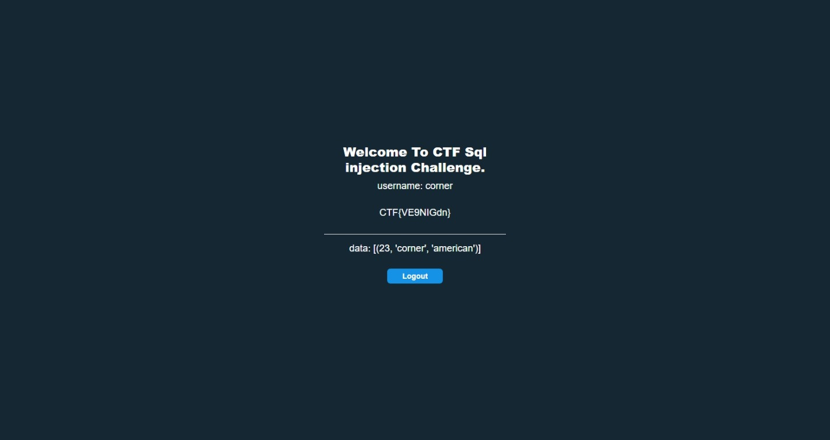

4.How to exploit a vulnerability? (exemple)
And here we are connected without password of admin i return us username: admin So we have baypassed the security of login with this payload

Slide 13
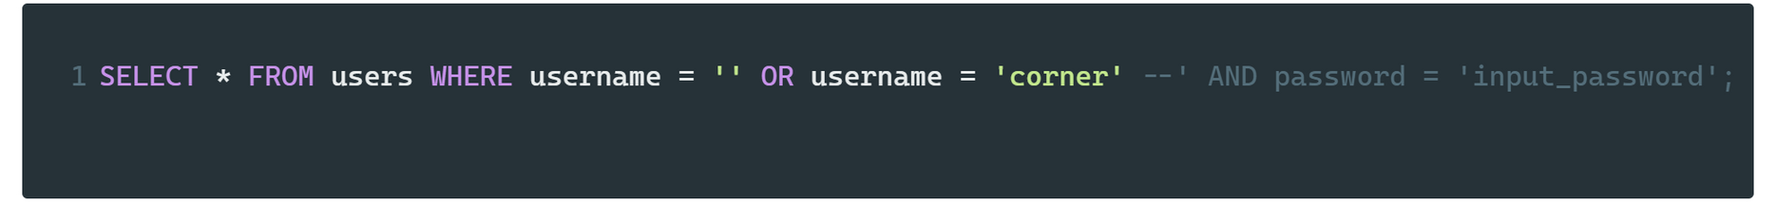
--
4.How to exploit a vulnerability? (exemple)
in sql is like a comment
How does it work?
Our Query (requete SQL):
Payload:
After injection, the modified query would look like:

Slide 14


5.Why does it happen?
Lack of Input Validation
Issue:
Failure to validate and sanitize user inputs before incorporating them into SQL queries.
Impact:
Attackers exploit this weakness by injecting malicious SQL code, leading to unauthorized access and data manipulation.
Lack of Parameterized Queries:
Issue:
Failing to use parameterized queries, where user inputs are treated as data, not as part of the SQL query structure.
Impact:
Parameterized queries separate user input from the query, preventing SQL injection attacks.

Slide 15



5.Why does it happen?
Unrestricted Database Privileges:
Issue:
Assigning excessive database privileges to application accounts.
Impact:
Attackers with compromised accounts can execute harmful SQL statements.

Slide 16
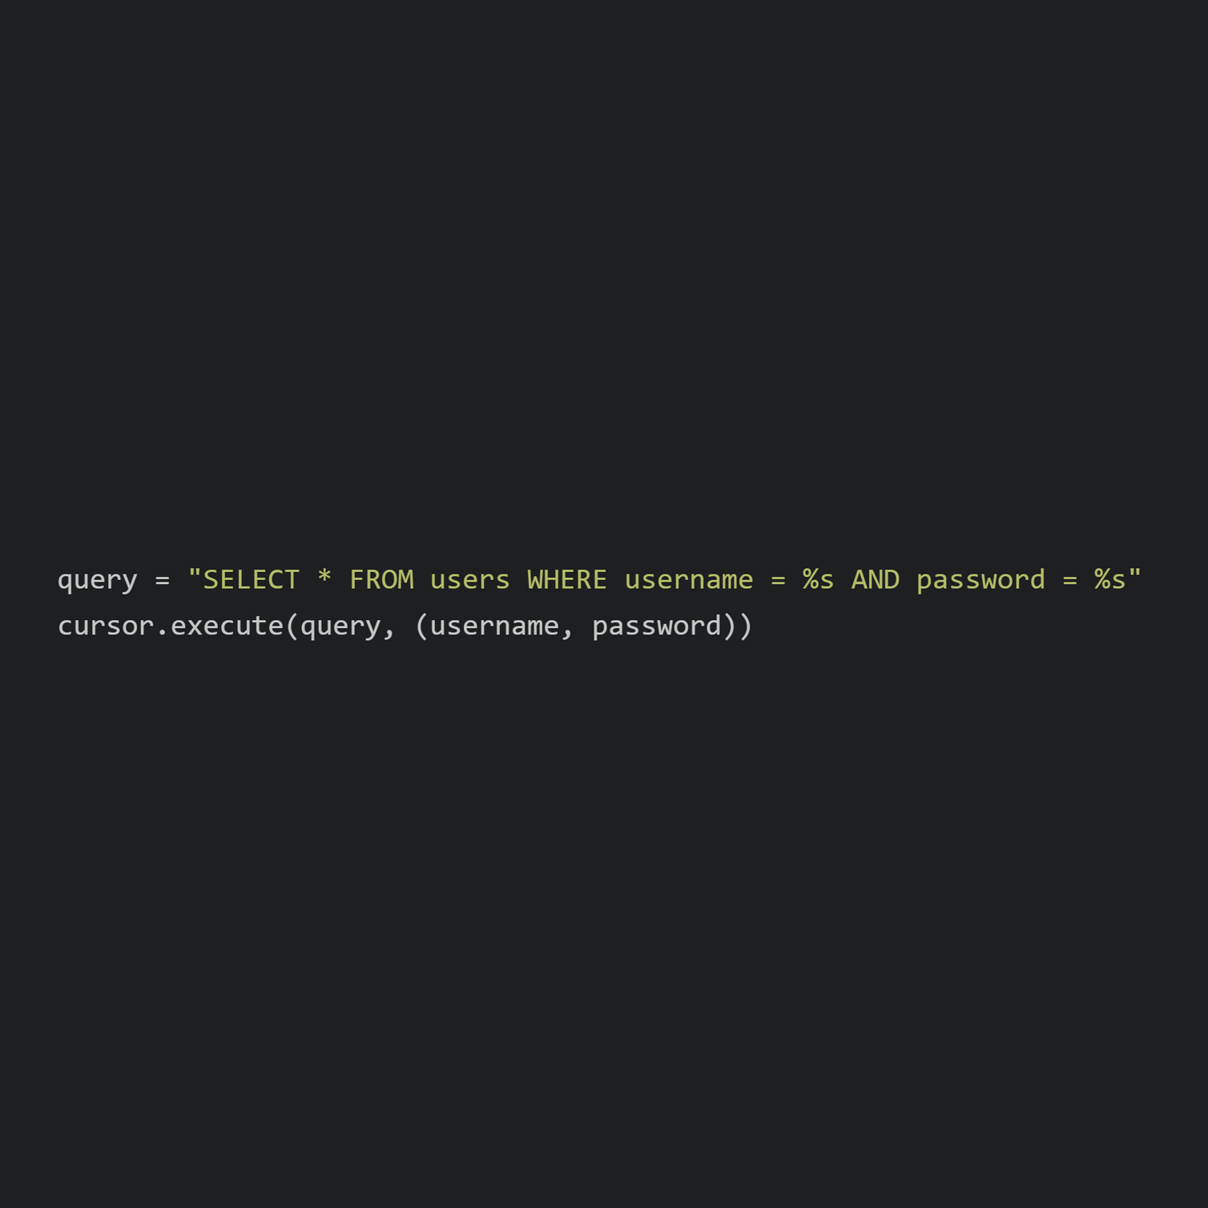
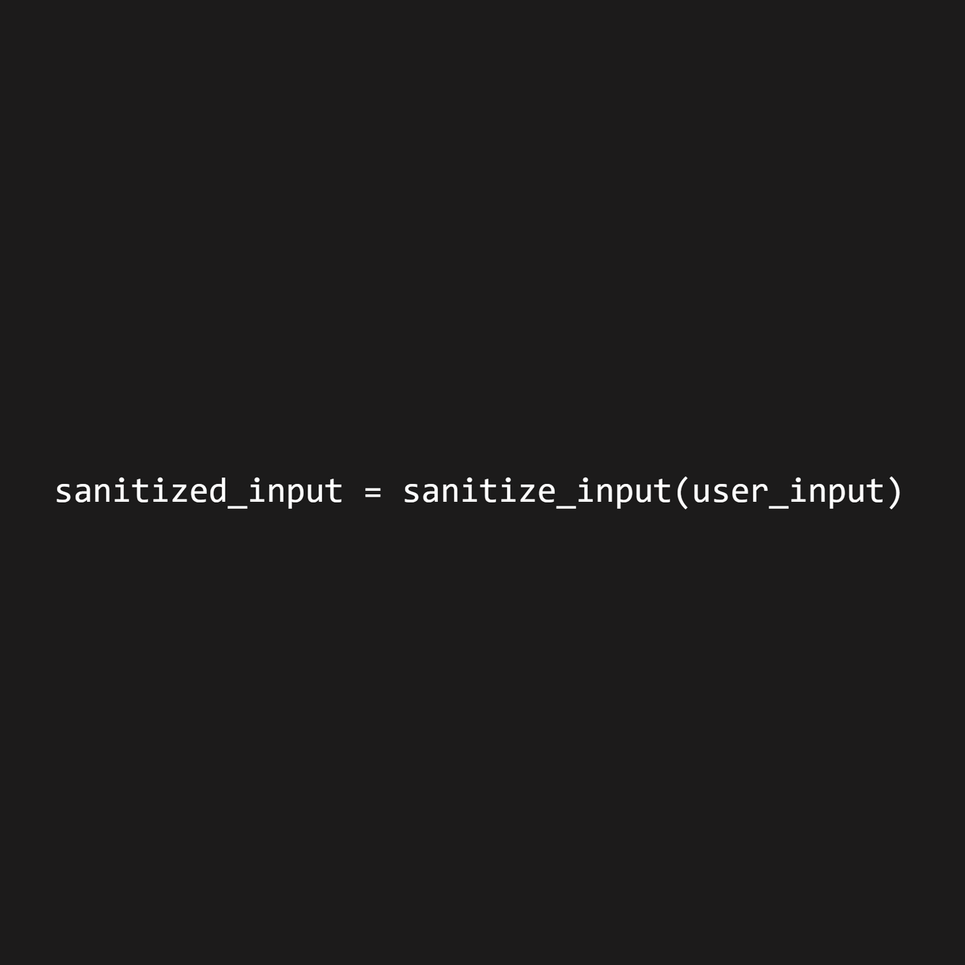
6.How to resolve it?
Best Practices and Security Measures:
Resolving SQL injection vulnerabilities requires a combination of best practices and security measures throughout the software development lifecycle.
1. Use Parameterized Queries:
Utilize parameterized queries to safely handle user input and prevent SQL injection attacks.
2. Implement Input Validation:
Use input validation to ensure that user inputs meet expected formats and do not contain malicious content.

Slide 17




6.How to resolve it?
3. Educate Python Developers:
Provide Python developers with training on secure coding practices, emphasizing the risks associated with SQL injection and how to avoid them.
4. Security Audits and Testing:
Conduct security audits and testing of your Python application using tools like Bandit or Safety to identify and address potential vulnerabilities or work with pentester

Slide 18




7.The dangers of SQL injection vulnerability:
Risks
Unauthorized Access:
Data Manipulation
Bypassing Authentication:
Financial Loss and Legal Consequences:
Attackers can exploit SQL injection to gain unauthorized access to sensitive information, such as user credentials, personal data, and proprietary business data.
Malicious actors can manipulate or delete data within the database, leading to data corruption, loss, or unauthorized alterations.
Attackers can bypass authentication mechanisms by injecting malicious SQL code, gaining access to secure areas and compromising user accounts.
Organizations may face financial losses due to data breaches, and legal consequences may arise from failing to protect sensitive information.

Slide 19

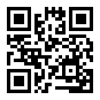
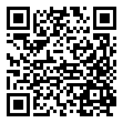


THANK YOU! FOR PARTICIPING
If you have questions you can contact me
Developing_off
ys-dev.me
younesarni
team.openminds
MY
Social Media
Code source of this workshop
(github)
open.minds.oran
END

